Slide 1

STATS 250 Lab 2
Jiangyue Mao

Slide 2
Course Reminders
Assignment | Due Date
Homework 3 | Thursday, February 2nd by 11:59pm
M-Write #1 Supplement | Thursday, February 2nd by 11:59pm
Be sure to review the homework solutions and feedback
Some answers will have personalized feedback
Some answers get graded for completeness (be sure to compare your answers to the posted solutions)
Reach out to me if you have any questions about grading!

Slide 3
M-Write
M-Write is a UM program that integrates writing-to-learn assignments into introductory courses in STEM
Over the course of this semester, we will have two M-Write prompts
Each prompt has four steps:
Supplement – due Thursday, February 2nd by 11:59pm
First Draft – due Wednesday, February 8th by 11:59pm
Peer Reviews – due Sunday, February 12th by 11:59pm
Final Revision – due Friday, February 17th by 11:59pm

Slide 4
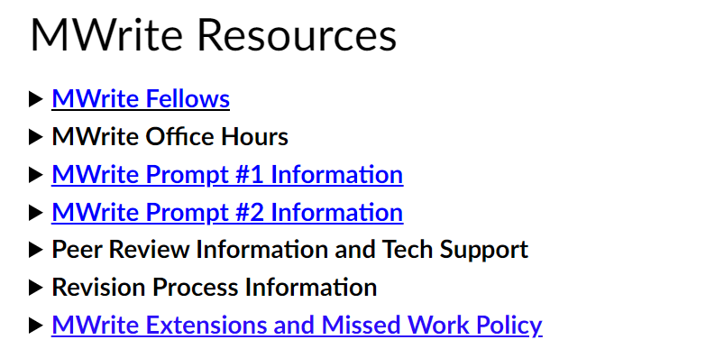
M-Write
Find helpful information at the bottom of the Student Resources page on Canvas!

Slide 5
Today’s Topics
Statistical Objectives
Practice with histograms and boxplots
Revisit the five-number summary of a variable
R Objectives
Calculate numerical summaries
Make a histogram
Make a boxplot
Make a side-by-side boxplot (plot by group)
Calculate numerical summaries by group

Slide 6
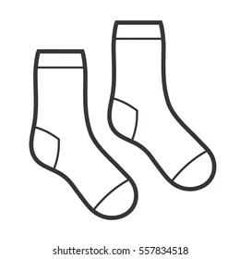
Describing Distributions
We want to provide a full picture of the data
Shape (unimodal/bimodal, symmetric/bell-shaped/symmetric)
Outliers (observations that deviate from the rest)
Center (mean/median)
Spread (range/IQR/standard deviation)
Don’t forget your S.O.C.S.

Slide 7
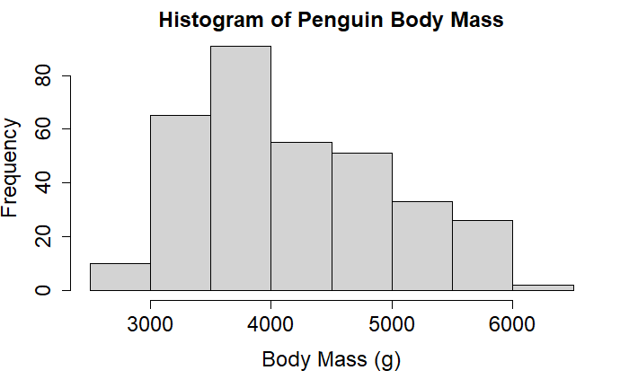
Histograms
Visualize the distribution of a quantitative variable
Most useful for determining shape
Unimodal/Bimodal
Symmetric/Bell-Shaped/Skewed
Approximate center, overall range, and potential outliers
Note: use numerical summaries for exact values, when available

Slide 8
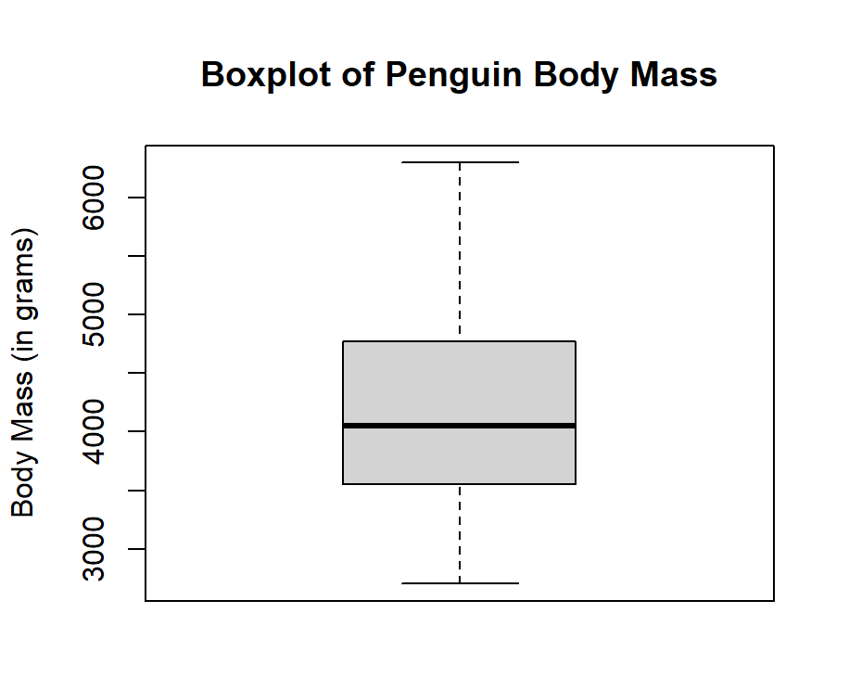
Boxplots
Visualize the five-number summary for a quantitative variable
Great for the center (median), spread (range or IQR), and outliers
Can’t be used to determine shape!

Slide 9
Five-Number Summary
Max (100th percentile)
Q3 (75th percentile)
Median (50th percentile)
Q1 (25th percentile)
Min (0th percentile)

Slide 10
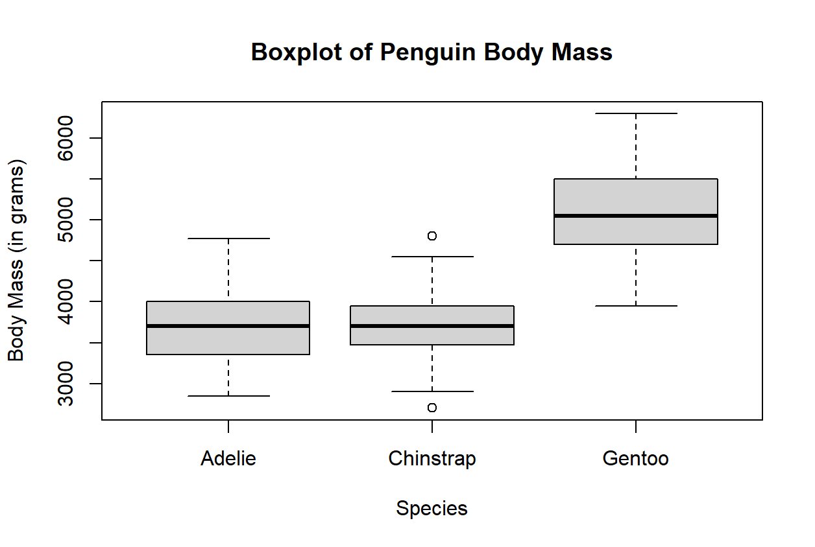
Boxplots
Also great for side-by-side comparisons

Slide 11
Lab 2
Head to https://rstudio.cloud/
If you are not signed in…
Click on “Log In”
Click “Log In with Google”
Log In with your UM credentials
Click the “Start” button next to the “lab02” assignment

Slide 12
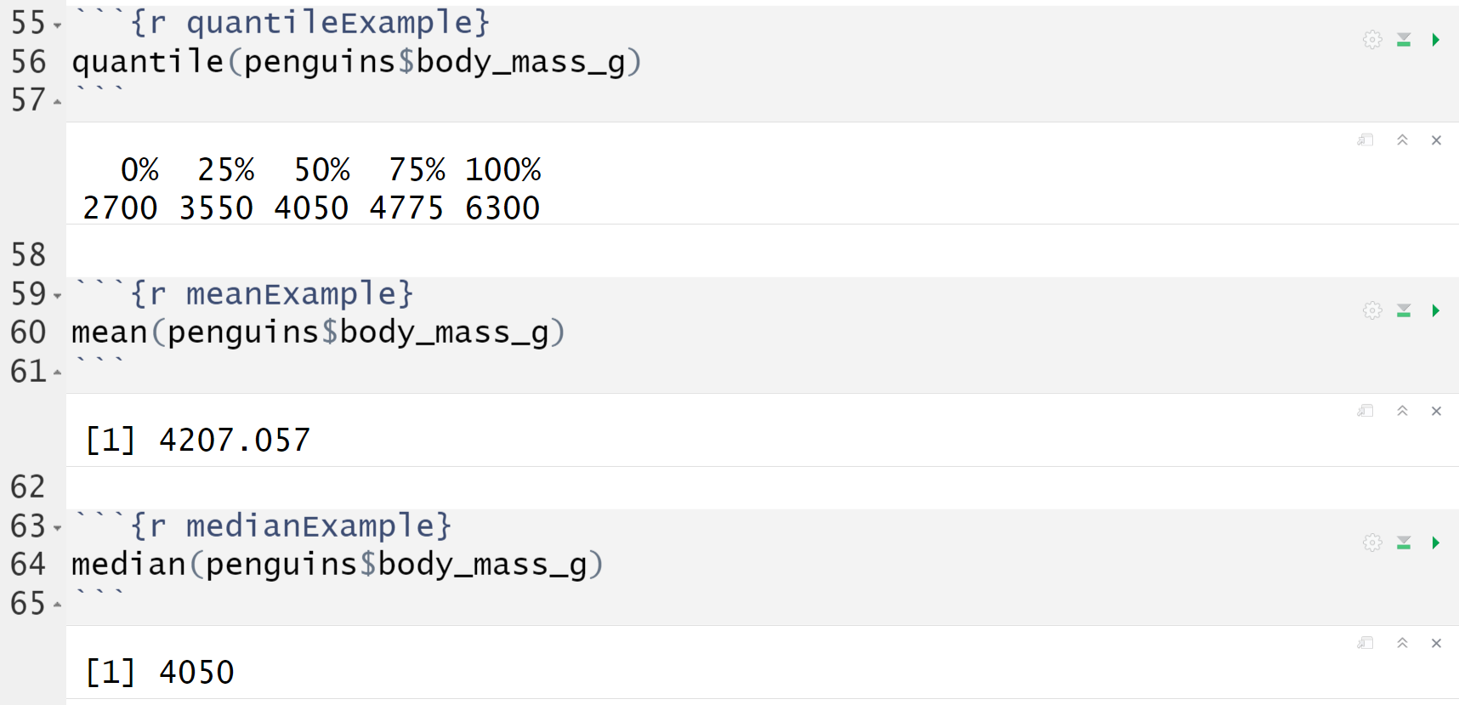
Numerical Summaries
There are various functions to help compute numerical summaries

Slide 13
Demo #1
Calculate the quantiles for the variable flipper_length_mm

Slide 14
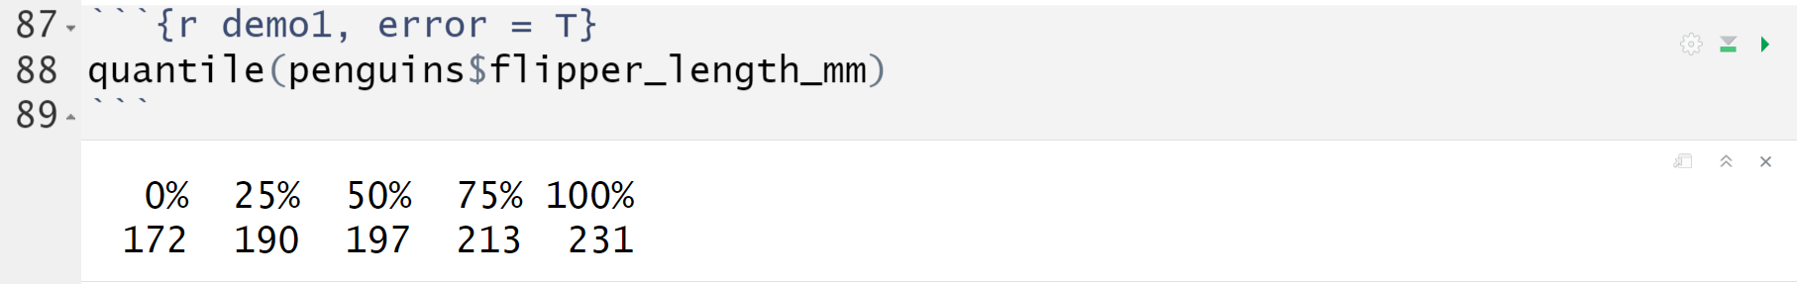
Demo #1
Calculate the quantiles for the variable flipper_length_mm

Slide 15
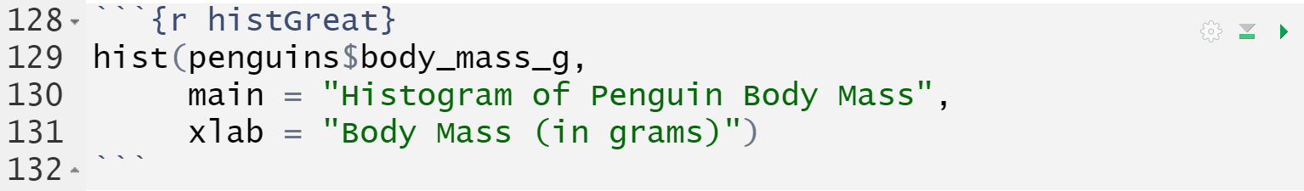
hist()
Creates a histogram of the variable
Remember, each “argument” gets separated with a comma

Slide 16
Demo #2
Create a histogram for penguin flipper lengths. Be sure to include an appropriate x-axis label and title. Add some color to your plot if you'd like!

Slide 17
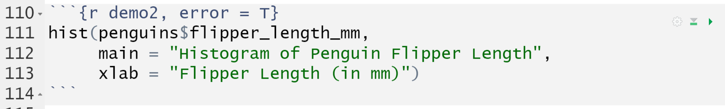
Demo #2
Create a histogram for penguin flipper lengths. Be sure to include an appropriate x-axis label and title. Add some color to your plot if you'd like!

Slide 18
Think-Pair-Share #1
Think: individually reflect on the question
Pair: discuss with a small group
Share: discuss with the entire lab section
The distribution for penguins flipper lengths is bimodal. What might cause this distribution to have two peaks? Think about the other variables in the data set. What graph could help us check this theory?

Slide 19
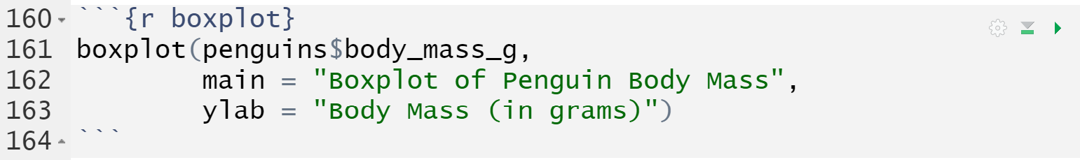
boxplot()
Creates a boxplot of the variable
Be sure to give your boxplot a proper title and y-axis label

Slide 20
Demo #3
Create a boxplot for the penguin flipper lengths. Include an appropriate y-axis label and title.

Slide 21
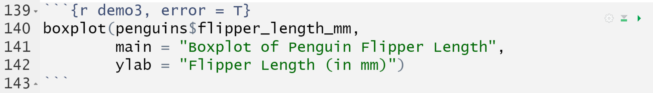
Demo #3
Create a boxplot for the penguin flipper lengths. Include an appropriate y-axis label and title.

Slide 22
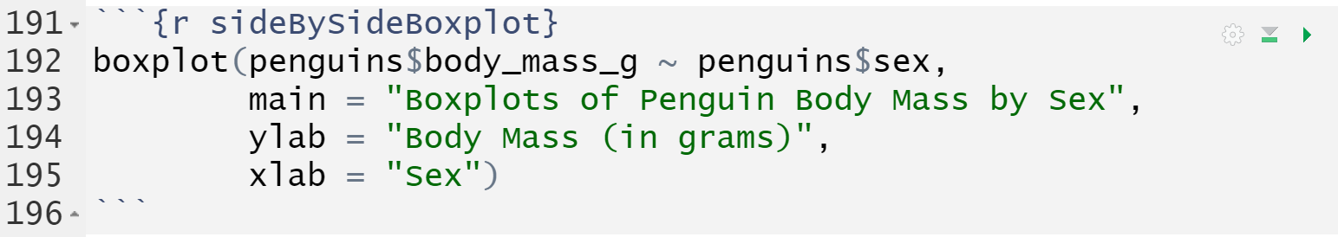
boxplot()
We can create a side-by-side boxplot by adding a categorical variable
This is a boxplot of “body mass by sex”
Order matters!
The quantitative variable must go first, followed by the categorical variable

Slide 23
Demo #4
Create a side-by-side boxplot of the penguin flipper length by species. Be sure to include appropriate labels and a title. Feel free to add some color!

Slide 24
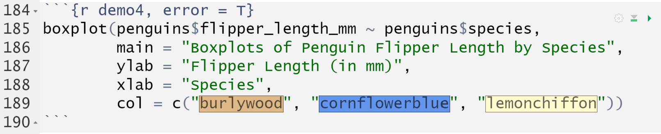
Demo #4
Create a side-by-side boxplot of the penguin flipper length by species. Be sure to include appropriate labels and a title. Feel free to add some color!

Slide 25
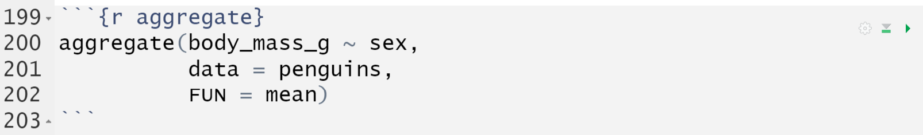
aggregate()
Calculates a numerical summary by group
We do not provide the name of the data set with each variable
“data” is a separate argument that we must include
The “FUN” (function) argument can be any numerical summary
min, max, mean, median, sd, IQR, etc.

Slide 26
aggregate()
Calculates a numerical summary by group
Once again, order matters!
The quantitative variable must go first, followed by the categorical variable

Slide 27
Demo #5
Calculate the quantiles of flipper length across the various penguin species.
Note: if you run your code and no output appears, try knitting the document! This function can be a little finicky sometimes (and sometimes the values only show up in the html file).

Slide 28
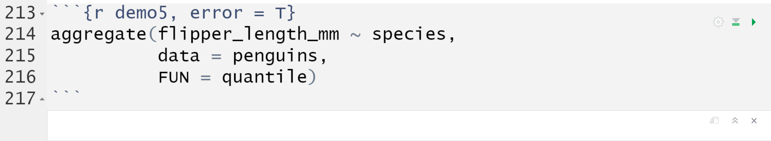
Demo #5
Calculate the quantiles of flipper length across the various penguin species.
Note: no output shows up! What happens if I knit the file?

Slide 29
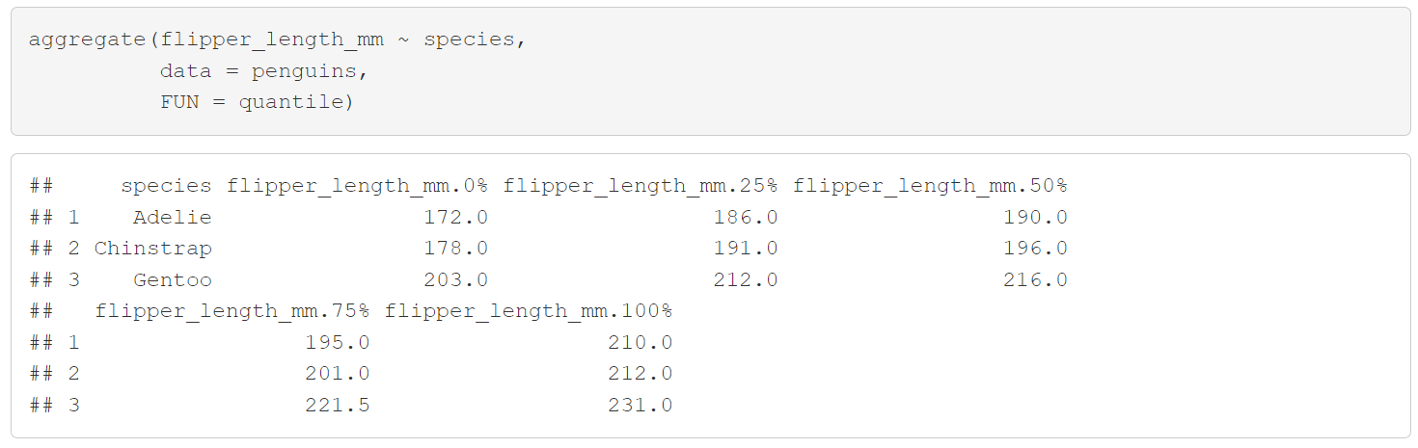
Demo #5
Calculate the quantiles of flipper length across the various penguin species.

Slide 30
M-Write
Those are all the new functions we have for today!
Click on the file titled mwrite1supplement.Rmd in the bottom right window to open the assignment for today.
We will read through the background together and jump into our second Think-Pair-Share.

Slide 31
Think-Pair-Share #2
Think: individually reflect on the question
Pair: discuss with a small group
Share: discuss with the entire lab section
Given this data set, what are some questions that we may wish to answer using health as the explanatory variable?
Think of one question that involves a categorical response

